Slide 1
Microsoft Copilot Studio Hands-on workshop

Slide 2
Agenda
Introduction to Microsoft Copilot Studio
Lab 1: Create your first Copilot in Microsoft Copilot Studio
Lab 2: Microsoft Copilot Studio: Authoring 101
Lab 3: Build and Invoke Power Automate cloud flows
Lab 4: Make HTTP requests to connect to an API
Lab 5: Knowledge sources, AI knowledge, and custom instructions
Lab 6: Use generative AI orchestration to interact with your connectors
Lab 7: Invoke AI Builder prompts
Q&A

Slide 3
Introduction to Copilot Studio

Slide 4
What is a copilot?
An experience using generative AI to assist humans with
complex cognitive tasks.
Chat using natural language (and code)
You determine, guide, and approve the output
Its value increases with complexity
Notes:
We get this question all the time: What exactly is Copilot?
Our definition – a copilot is an AI-driven partner that is guided by an individual or an organization to help amplify creativity and accelerate results.
The more complex the task, the greater the value that Copilot delivers.

Slide 5



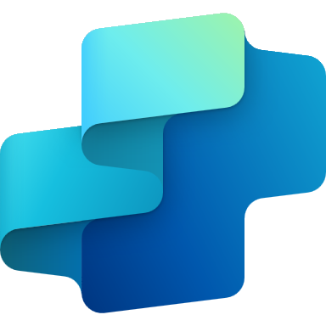
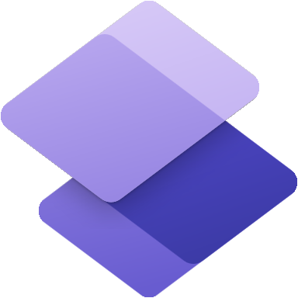





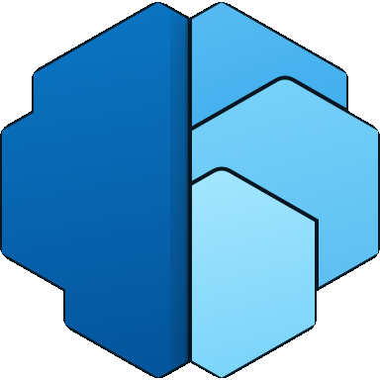
Microsoft Power Platform
The low-code platform that spans Office 365, Azure, Dynamics 365, and standalone applications
Power Apps
Application development
Power Automate
Process automation
Power BI
Business analytics
Copilot Studio
Intelligent copilots
Power Pages
External websites
Data connectors
AI Builder
Microsoft Dataverse
Power Fx
Managed
Environments
Notes:
Power Platform is a unified platform of low-code tools that spans Office 365, Azure, Dynamics 365, and standalone applications that helps you analyze data, build solutions, automate processes, and create virtual agents to transform your business.
Power Platform is a rapid application development platform that helps citizen developers with limited coding abilities to innovate and build new solutions faster in an environment and user experience that feels like PowerPoint and Excel.
Beyond use by citizen developers, Power Platform is a rapid application development and extensibility framework for professional developers that seamlessly integrates the high-speed capabilities of low-code tools and prebuilt components with no-cliffs extensibility across Azure and other professional development environments.
Power Platform truly is a transformative solution that brings together all kinds of developers and employees to collaborate and build solutions – whether no code, low code, or code first.

Slide 6

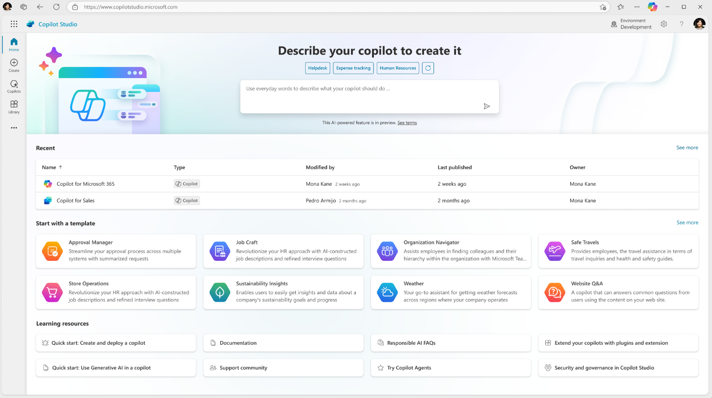
Announcement slide (dark) with color rotation
Microsoft Copilot Studio
Your copilot, your way
Copilot Studio is an end-to-end conversational AI product for
building your own copilots or extending Microsoft Copilot with generative AI, large language models and your data.

Slide 7



Different building journeys for different needs
Copilot Studio
Included in Copilot for M365
Standalone
Azure AI Studio
Customize Microsoft Copilot
Build your own custom copilots
Connect with your data sources outside of Copilots reach
Build customer or internal facing copilots with your data and workflows, on channels that work for you
Call your redesigned business processes and workflows
Rules-based dialog management and conversational orchestration with a prebuilt LLM
Configure LLMs with prompt engineering
Configure Copilot responses to specific questions
Managed SaaS, no infrastructure, built in security and governance
Manage own infrastructure, custom dev and security
Building Copilot Extensions
Build Conversational Orchestration
Build Models
Extend Copilot Studio with Azure AI Studio

Slide 8
The end-to-end copilot conversation
Copilot Studio Dialog Management
Authored Topics
STAGE 1
Unified Authoring Canvas
Copilot-assisted Authoring
1. Authored Topics
Organizations control their critical topics by designing their own specific processes and workflows.
2. Generated Responses
Generative AI answers queries at scale that may be duplicative or less complex.
3. Escalation
If the copilot can’t handle the conversation, it will escalate the conversation to a human assistant.
STAGE 2
Generated Responses
Generative Answers / Actions
GPT Models
Escalation
STAGE 3
Omni-channel
Live Agent Hand-off
Notes:
This shows how generated responses are plugged into a dialog manager (PVA) to ensure that you remain in control of the user experience while allowing for Authored experiences that are key functions of your bot, scripted responses that are key for managing the answers you want scripted (such as marketing controlled responses) work in conjunction with generated responses allowing the enterprise to remain in full control of the experience. This even allows for the escalation process to be properly managed. Having a dialog manager, such as Copilot Studio, is key to allowing for an end to end enterprise conversational platform to build effective and managed experiences that delight customers, while reducing the overhead and cost of maintaining fully scripted experiences of the past, while increasing the capabilities that these experiences can bring to their users.

Slide 9















Chart/data (dark)
Copilots and Conversational AI
Build and extend across the Microsoft ecosystem
Custom copilots
Microsoft 365
Biz Apps & Power Platform
Other Microsoft Copilots
Build Custom copilots and bots for enterprises and third parties
Extend Microsoft 365 Copilot
Extend Copilot experiences in Dynamics 365 and Power Products
Extend other Microsoft Copilot Experiences
Copilot for Sales
Copilot for Service
Power Platform
Microsoft Copilot Studio Build custom Copilots | Extend and customize 1st party copilots
Bot Framework / SDK
Bot Service Channels
Azure AI Studio
Azure Cognitive Services
Power Platform Connectors
AI Builder

Slide 10
Different building journeys for different needs
Copilot Studio
Included in Copilot for M365
Standalone
Azure AI Studio
Customize Microsoft Copilot
Build your own custom copilots
Connect with your data sources outside of Copilots reach
Build customer or internal facing copilots with your data and workflows, on channels that work for you
Call your redesigned business processes and workflows
Rules-based dialog management and conversational orchestration with a prebuilt LLM
Configure LLMs with prompt engineering
Configure Copilot responses to specific questions
Managed SaaS, no infrastructure, built in security and governance
Manage own infrastructure, custom dev and security
Building Copilot Extensions
Build Conversational Orchestration
Build Models
Our Focus today

Slide 11
Build & Publish
Copilot Studio
Analyze & Improve

Slide 12
How to build a custom copilot
Create a copilot Stand up Copilot Studio’s SaaS in minutes.
1
Start
Design the conversation
Connect your knowledge base for generative answers, create rule-based topics, integrate plugins and data connectors, and extend with Azure AI Studio.
2
Build
3
Publish to different channels Publish your copilot to Teams, websites, apps, social media channels and more.
Publish
Control and improve Monitor, manage and improve the copilot with enterprise-grade security and controls.
4
Manage

Slide 13
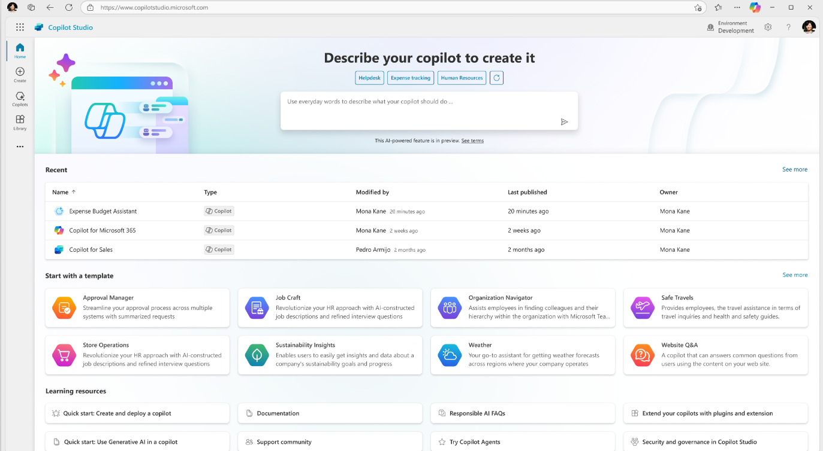
Build & Publish
Create a copilot
Build a copilot and go live within minutes, all from one easy-to-use, E2E SaaS product

Slide 14
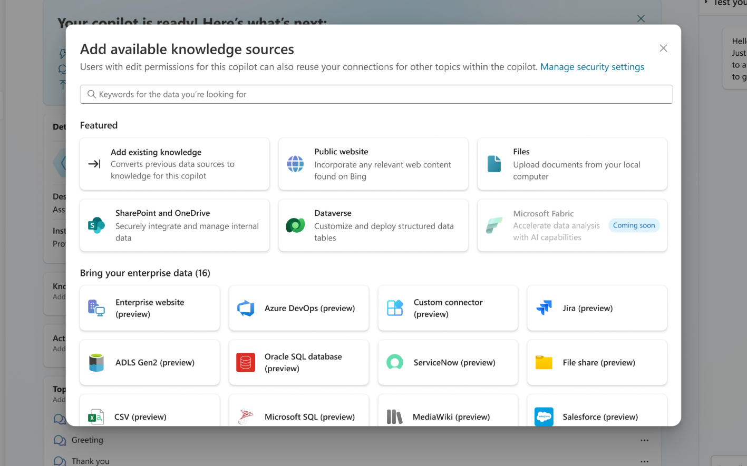
Build & Publish
Add knowledge
Connect to your enterprise backends and APIs with 1000s of pre-built data connectors
Analyze & Improve

Slide 15
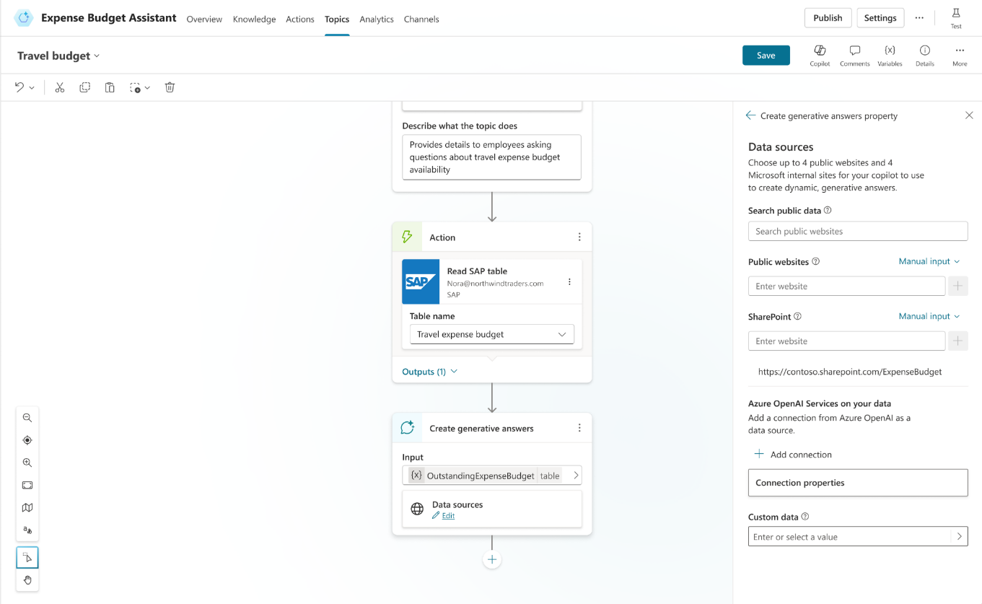
Build & Publish
Customize topics, and actions
Mix generative responses with step by step topics for complete control. Create actions, plugins and connect to your backend systems with 1000s of pre-built connectors

Slide 16
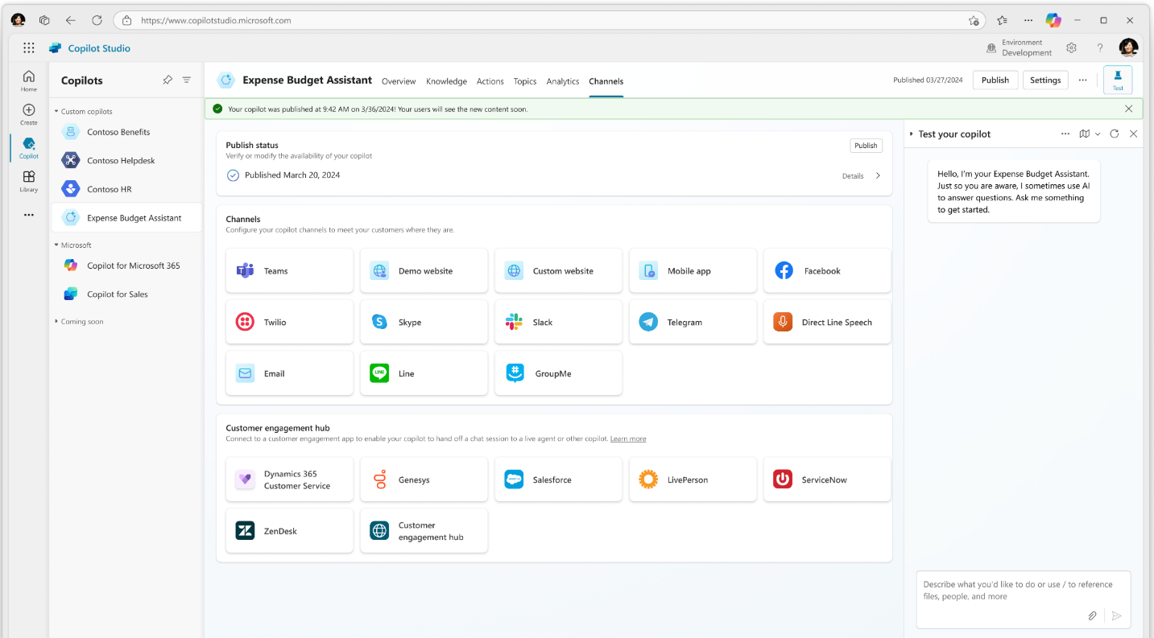
Build & Publish
Analyze & Improve
Publish and
go live instantly
Publish and deploy to the channel of choice with a single click, and your copilot is live.

Slide 17
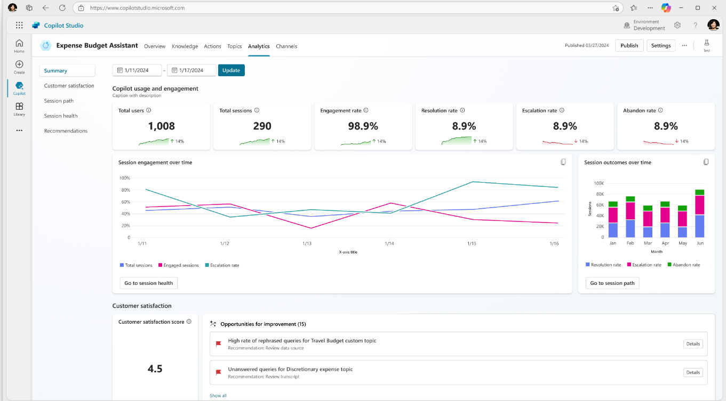
Analyze & Improve
Build & Publish
Monitor and
get insights
Understand what’s working well and what needs to improve
with conversational analytics

Slide 18
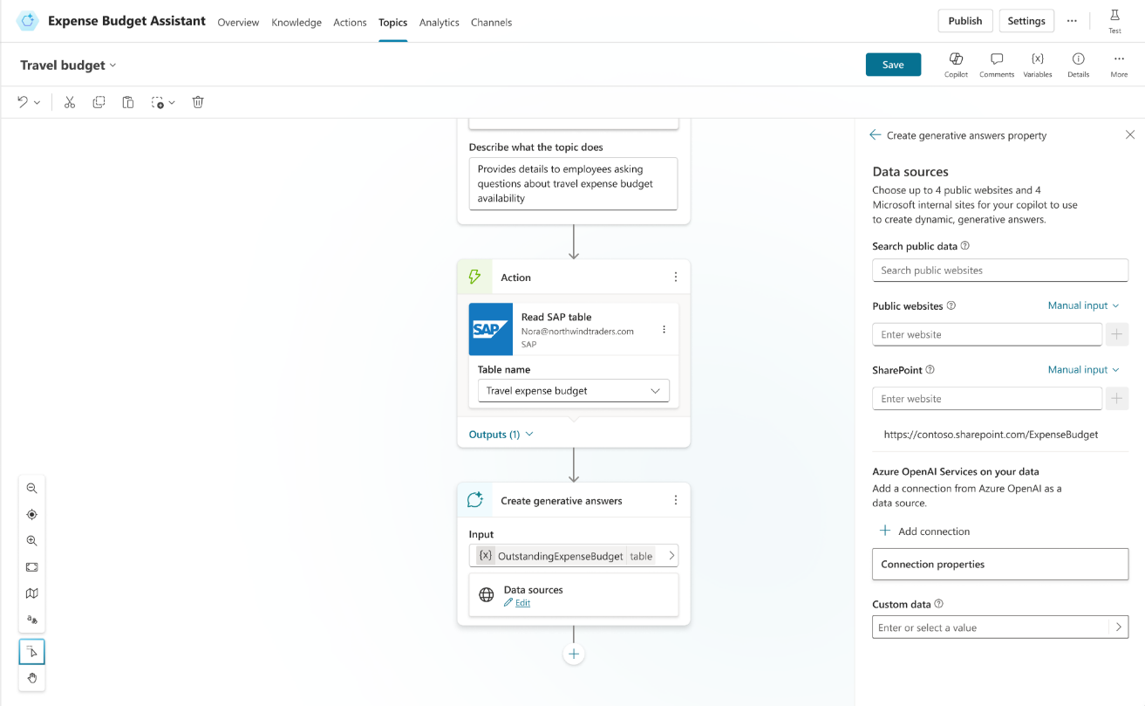
Analyze & Improve
Build & Publish
Fine tune to add sophistication
Layer in more topics with custom responses and conditions based on insights generated to improve your copilot’s performance.

Slide 19
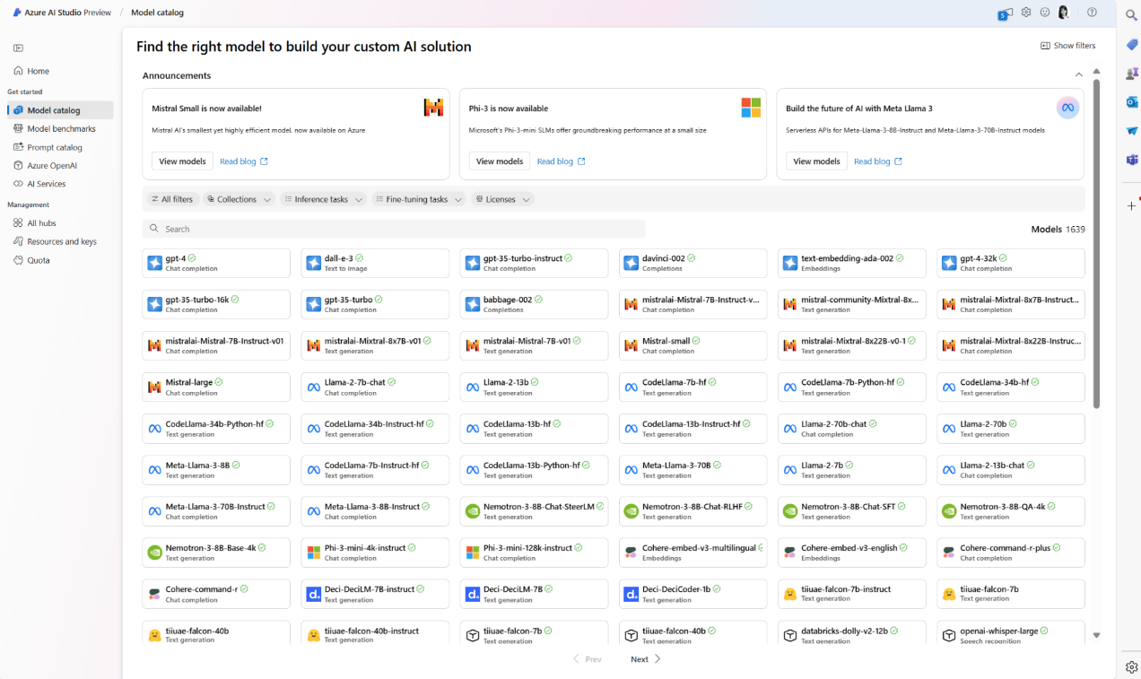
Analyze & Improve
Add Conversational
Services
Integrate with Azure AI Studio, Azure Cognitive Services, Bot Framework and a variety of other Microsoft conversational services

Slide 20
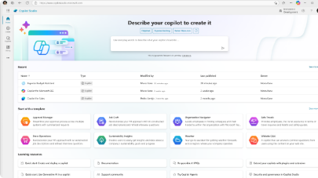
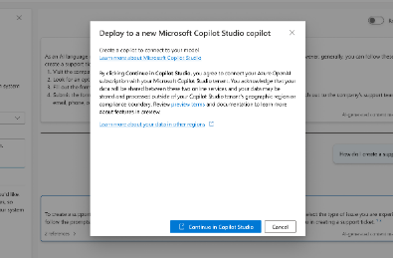
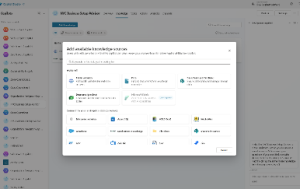
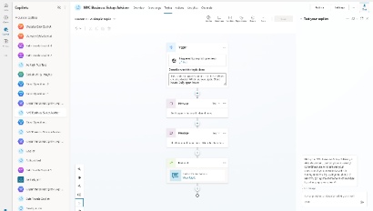
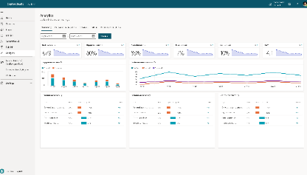
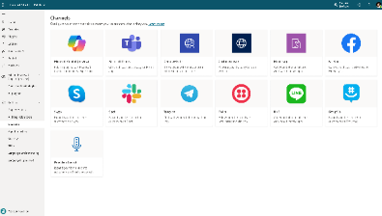
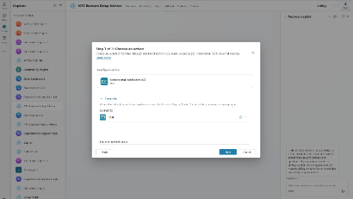
Copilot Studio
Create, manage, publish and extend Copilots Live in minutes - all from one tool and E2E SaaS service
Chat over knowledge with Gen AI Get enterprise specific answers over your files, websites, internal shares, Dataverse, third party systems and more
Integrate with AI Services Integrate with Azure AI Studio, Azure Cog Services, Bot Framework and various other Microsoft conversational services
Build & Publish
Create specific topics Supplement generative responses with specific, curated topics where you want tight control. Build them easily with the powerful graphical studio
Monitor and Improve with rich out-of-the-box insights and analytics
Copilot Studio
Build actions & Plugins Create actions, plugins, use 1000s of pre-built connectors or Power Automate to call your backends and APIs
Publish to multiple channels, and go live instantly on the SaaS service or choose to extend Copilot for Microsoft 365 with your custom capabilities
Analyze & Improve

Slide 21



Example use cases to build copilots today:
B2C
B2B
B2E
Customer Support
Supplier Interaction
Human Resources
Build your own copilot
Handle routine customer inquiries, providing instant responses and freeing up human agents for more complex issues.
Facilitate communication between businesses and their suppliers, managing orders and track shipments.
Interface with your ERP/HR systems to simplify processes.
Ask your copilot
Ask your copilot
Ask your copilot
Start the onboarding process and required tasks for new colleague
How do I return a product?
How do I reset my account information?
What’s the status of our latest component order?
Expense Management
Extensibility
Products/Services
Lead qualification
Interface with your ERP systems to streamline your finance or resource planning processes.
Assist customers with product and service discovery based off your website.
Qualify leads by asking relevant questions and then route them to the appropriate sales representative.
Ask Copilot
Ask your copilot
Ask your copilot
Send me a list of pending expenses from this week.
What is the latest laptop? Can I fit it in my 15” backpack?
Can you provide me with information on your bulk pricing for office supplies?
An employee can have a Copilot for M365 license and still want a custom copilot. Audiences typically without Copilot for M365 like frontline workers.

Slide 22


Generative AI is changing bot building
Traditional (e.g. Azure)
Create Azure tenant and infra
Annotate thousands of utterances and conversations to build a custom NL model
Create topics in code using Visual Studio and BF SDK
Host Azure Bot Service and instantiate the appropriate channel
Deploy your bot to the service
Build your own custom analytics pipeline
Every time your knowledge content changes (e.g. different hours) go and update the bot in code
Manually authored topics
Anticipate and build a manual topic for each possible user question
BUSINESS CRITICALITY
Missed opportunity
Time spent hand-building topics
Conversations missed or escalated
TOPICS BUILT
Notes:
.

Slide 23
Generative AI is changing bot building
Copilot Studio with Generative AI
Full E2E SaaS – no infra to host or manage
No explicit NL training or custom model required, comes with powerful large language model
Point to a knowledge sources and have a useful bot in minutes with Generative AI
Extend the bot with business-critical topics using easy to use graphical interface and 1000s of pre-built connectors, or call custom APIs
Developers, low-code users can collaborate inside the same canvas with graphical multi-authoring and code side-by-side
Publish to the channel of your choice in minutes with a few clicks
Manually author business critical topics quickly with Copilot and Copilot Studio’s intuitive builder
BUSINESS CRITICALITY
Expose your knowledge sources and APIs and generative AI handles the rest
Custom build topics + help from Copilot
Topics handled by Generative Answers and Actions
TOPICS BUILT
Notes:
.

Slide 24












Announcement (dark)
More than 30,000 customers across every industry have used Copilot Studio
to help improve performance and efficiency while reducing costs and risks
Conversational banking copilot on both telephony and digital channels
HR/IT copilot for employees that reduced support costs and workload
Helping customers find and book the perfect cruise
Creating customer focused copilots as a Microsoft Partner
Customer copilot to help find the right products and support
Copilot that helps with customer service for guests

Slide 25

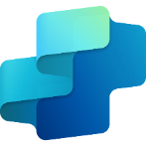
Copilot Studio
Copilot Studio
message capacity add-on
$200 per tenant/month
Tenant-wide capacity license sold in capacity packs.
1 capacity pack = 25,000 messages/month
Offer Details
Gen AI: AI-enabled conversations
Copilot in Microsoft Copilot Studio: Create and iterate on chatbot topics using expanded natural language capabilities
Power Automate for Microsoft Copilot Studio: Cloud flows – Create automated, instant and scheduled flows within context of Microsoft Copilot Studio bots
Connectors: Standard, Premium and Custom connectors
Dataverse for Microsoft Copilot Studio: Dataverse Default Capacity
5 GB Database Capacity
20 GB File Capacity
2 GB Log Capacity
All pricing subject to change, please consult price list for actual pricing.

Slide 26
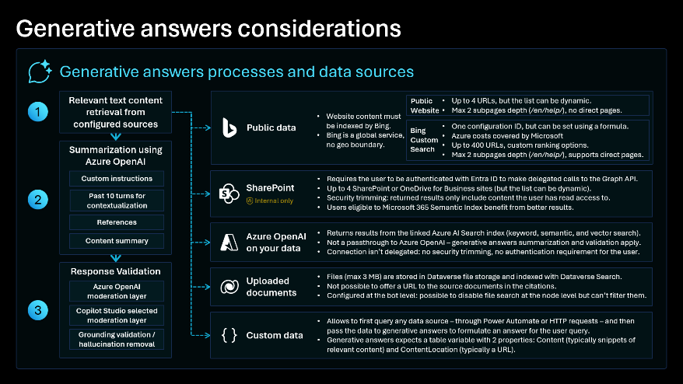
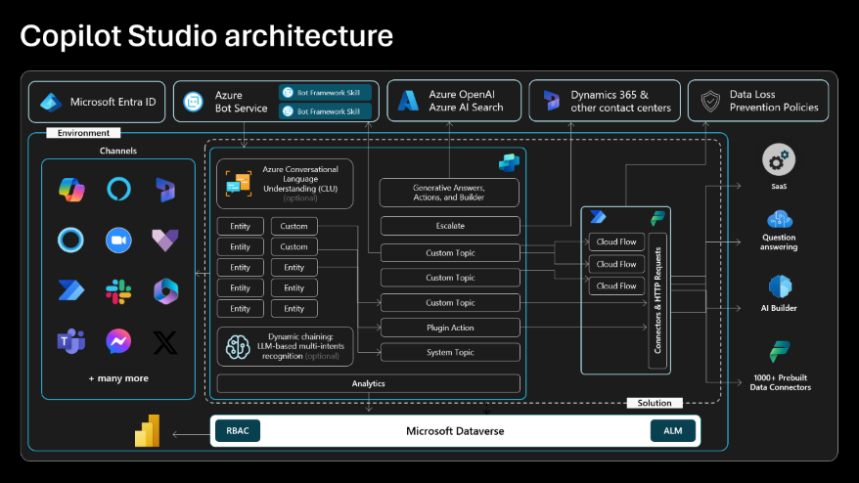
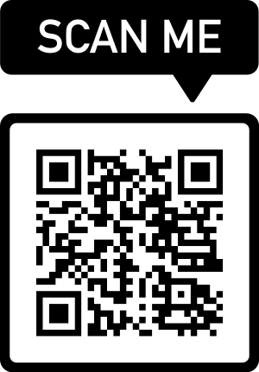
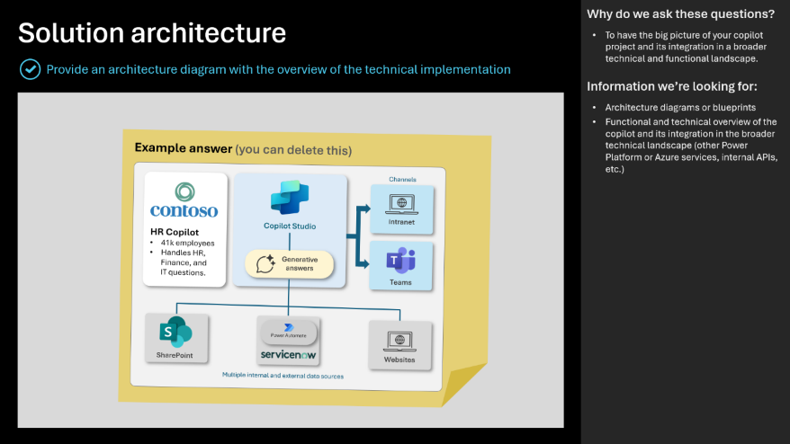
Copilot Studio Implementation Guide
The Copilot Studio implementation guide provides a framework to do a 360-degree review of a copilot or bot project.
Through probing questions, it highlights potential risks and gaps, aims at aligning the project with the product roadmap, and shares guidance, best practices and reference architecture examples.
aka.ms/CopilotStudioImplementationGuide

Slide 27
Get Started

Slide 28
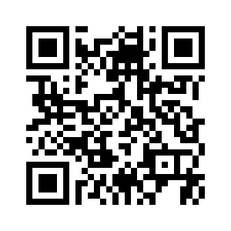
Go to aka.ms/CopilotStudioWorkshop
THEN:
Download and unzip the lab files locally.
Using the provided credentials, log in aka.ms/CopilotStudioStart
SCAN ME

Slide 29
Important lab instructions
Follow the labs most lab content is dependent on previous labs.
If you want to deviate from the labs and test your own scenarios, this is fine, but please do complete the labs first, and create your own separate custom copilot for your own scenarios and exploration after you’ve completed the labs.

Slide 30
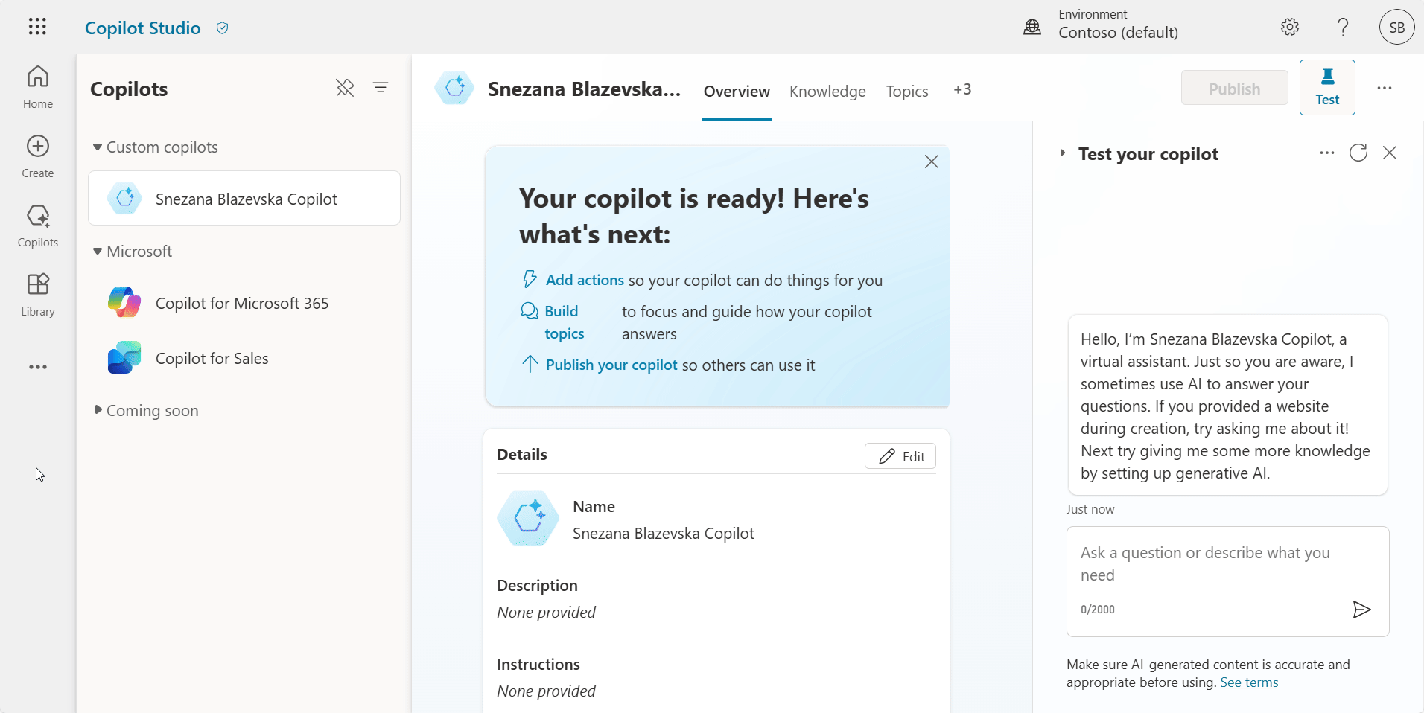
Productivity tip #1: Unpin the Copilots pane

Slide 31
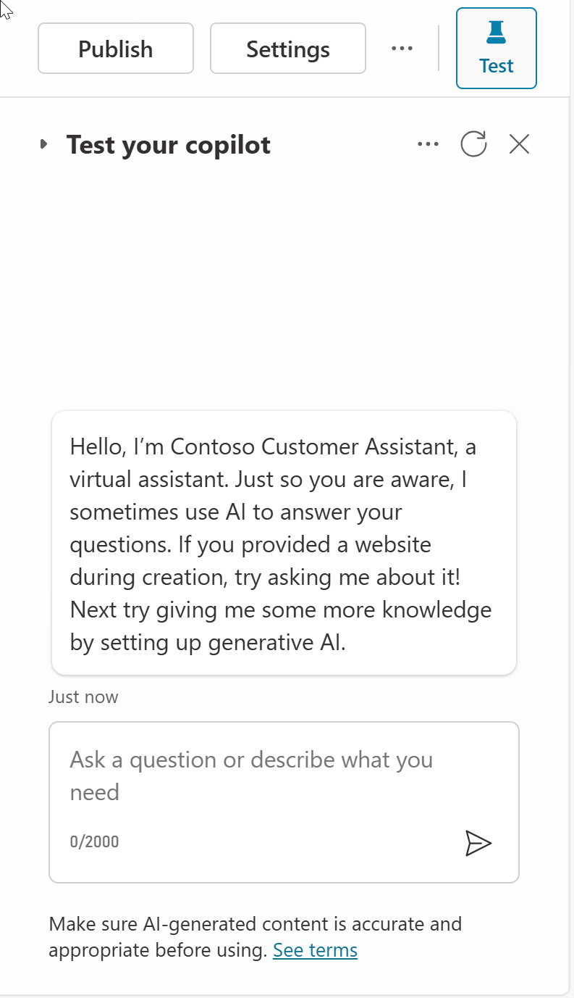
Productivity tip #2: Refresh the conversation between tests

Slide 32
Lab 01: Create your first copilot in Microsoft Copilot Studio

Slide 33
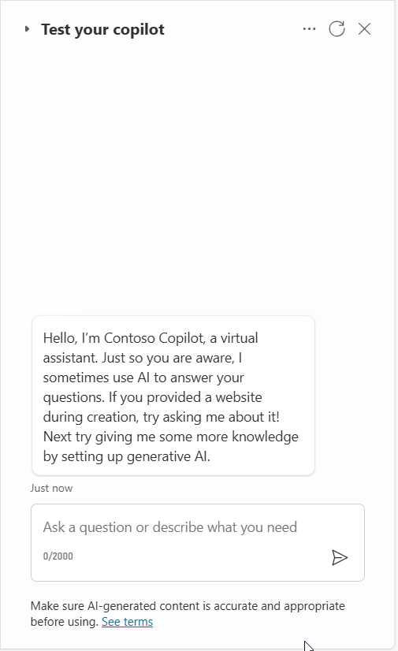
Demo Lab 1

Slide 34
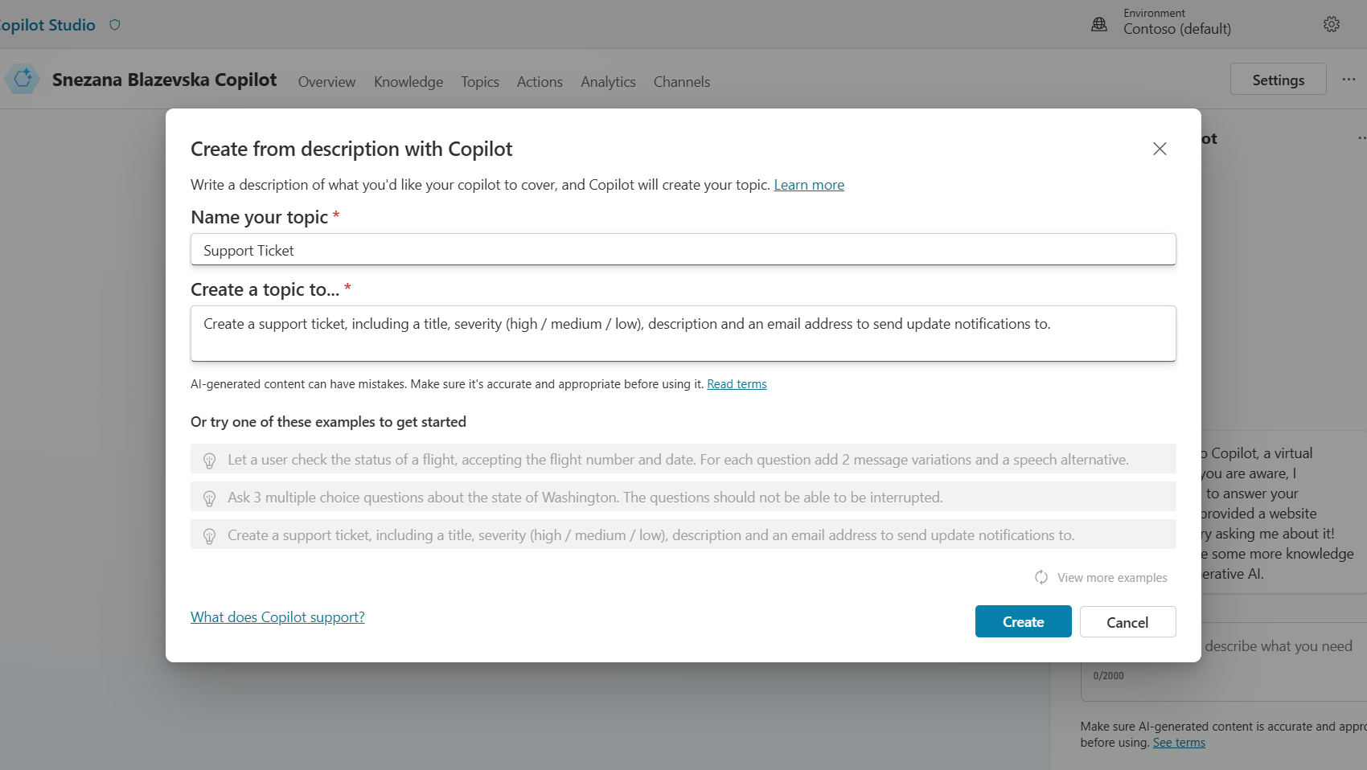
Copilot for Copilot Studio
AI assistance in building topics, designing and modifying the copilot all through natural language
Assisted authoring for:
Topic creation
Topic iteration
Response generation
Adaptive Card generation
Topic improvement suggestions
Suggested trigger phrases, topic names, topic descriptions
Transcript generation
Copilot creation
Topic suggestions
Azure bots take months to author
Copilots took days to author
Prompt-authored copilots will take hours or even minutes to author.
Generally Available

Slide 35
Lab time!
Lab 01 [40] minutes

Slide 36
Lab 02: Authoring 101

Slide 37
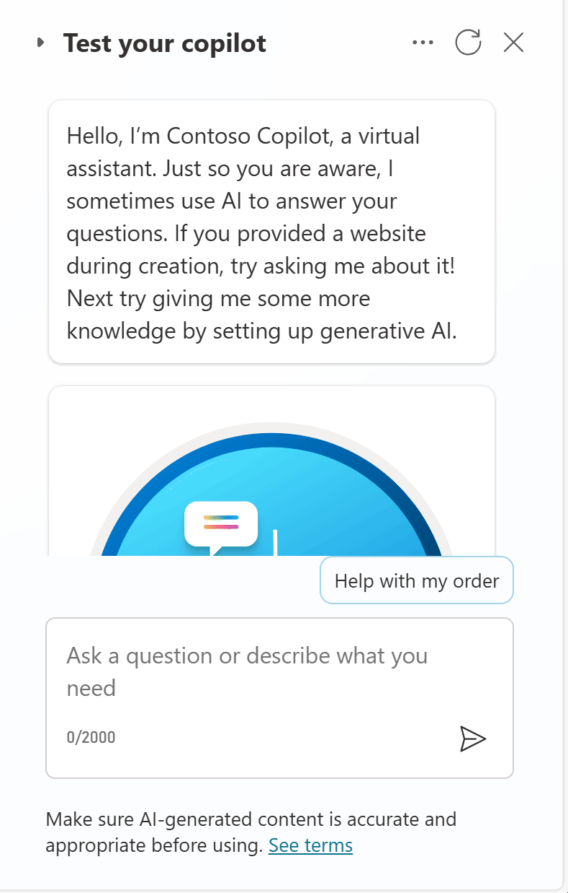
Demo Lab 2

Slide 38
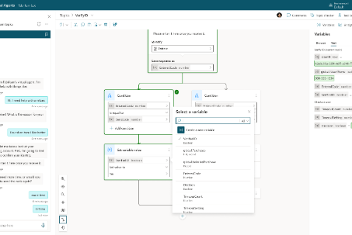
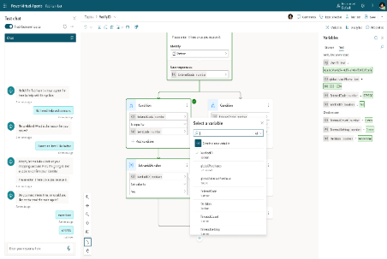
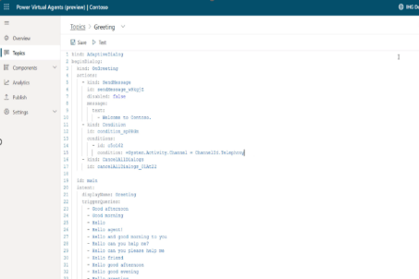
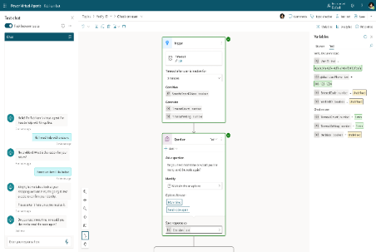
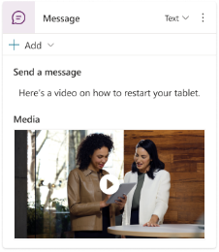
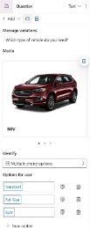
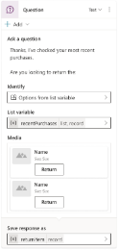




Copilot Studio authoring canvas
Rich Responses
Power Fx-based variables system
Code side-by-side
Event-driven & contextual triggering
Productivity
New features including:
Power Fx integrated formula editor for variable management
List / Record type support
Condition nodes with Power Fx formula support
Iterate over a List with new Loop nodes (coming soon)
Move between a visual editor and code
Share and re-use topic logic between developers and bots
Trigger an event that can interrupt Dialogs if it detects a certain value has been received
Add more nuanced responses to a message when the bot runs into an issue.
Bots can stay within context when a user asks for additional help or more details
Cut, Copy, Paste
Multi-node selection
Enhanced topic navigation
Adaptive Cards
Images
Videos
Quick Replies

Slide 39
Lab time!
Lab 02 [60] minutes

Slide 40







Disambiguation with topic design
Natural Language Understanding Trigger phrases | “Trigger Phrases” Topics Triggered from trigger phrases or redirects | Reusable, Bite-Size, Topics Explicitly called by topics
Topic: Card
Topic: Debit Card
Issue with my card
Block card
I need to block my credit card
Need help blocking debit card
Unblock card
Need to unblock credit card
How to unblock my debit card
Question: Debit/Credit
…
Question: Block/Unblock
Condition
Topic: Credit Card
Debit
Credit
…
End of Conversation
Topic: End of Conversation
Topic: Location
…
Find my nearest bank
Check branch location
Find a bank
Find me your nearest location
Banks near me
Question: Location
Location
Topic: Location Check
Message
…
End of Conversation

Slide 41



Natural language understanding
Standard NLU model
Custom Azure CLU model
Generative AI orchestration
Default, out-of-the-box, model that comes pre-trained, with many predefined entity types.
Configuration is done by adding trigger phrases and custom entities (either closed lists with values and synonyms, or regular expressions).
Supports additional languages, with native models.
Allows to further customize the intent triggering model for better intent recognition or to address specific industry requirements.
Allows for complex entity extraction (e.g., of the same type).
Entity extraction can also leverage Copilot Studio standard NLU.
Uses a GPT large language model.
Can handle multiple intents and chain topics and/or plugins.
Automatically generate questions for missing inputs and answers complex entities and questions from the conversation context.
Configuration is done by simply describing topics, plugin actions, and inputs/outputs.
Single intent recognition per query.
Cannot be extended.
Slot-filling multiple entities of the same type in the same query requires disambiguation for each (e.g., from and to cities)
Single intent recognition per query.
Configuration is done in Azure and involves additional costs.
Has its own service limits that need to be evaluated.
Azure CLU intents and Copilot Studio topics must be carefully kept in sync.
As it’s a generative AI feature, the licensing burn rate of messages is higher than in regular topic triggering.
Preview capability.

Slide 42
Handling unrecognized intents
Answering for unplanned user queries
1
3
The fallback topic gets triggered when Copilot Studio doesn't understand a user utterance and doesn’t have sufficient confidence to trigger any of the existing topics.
If knowledge sources are enabled on the copilot, the conversational boosting topic also triggers on the unknown intent event and triggers before the Fallback one.
2
4
There are many ways to handle unrecognized intents: using the AI’s own general knowledge, or knowledge sources to ground the answer in your own data sources and/or using the Fallback topic to integrate with any other systems. For example, question answering in Azure AI for Language allows you to offload large volumes of question-and-answer pairs. It also has a chitchat model to handle random questions to the copilot.
While it’s important to leverage the Conversational Boosting and Fallback capabilities, it’s also important to make sure that the core scenarios and topics of your copilots are property handled through custom topics and their outcomes defined (resolved, etc.).

Slide 43
Lab 03: Build and call Power Automate cloud flows from your copilot

Slide 44
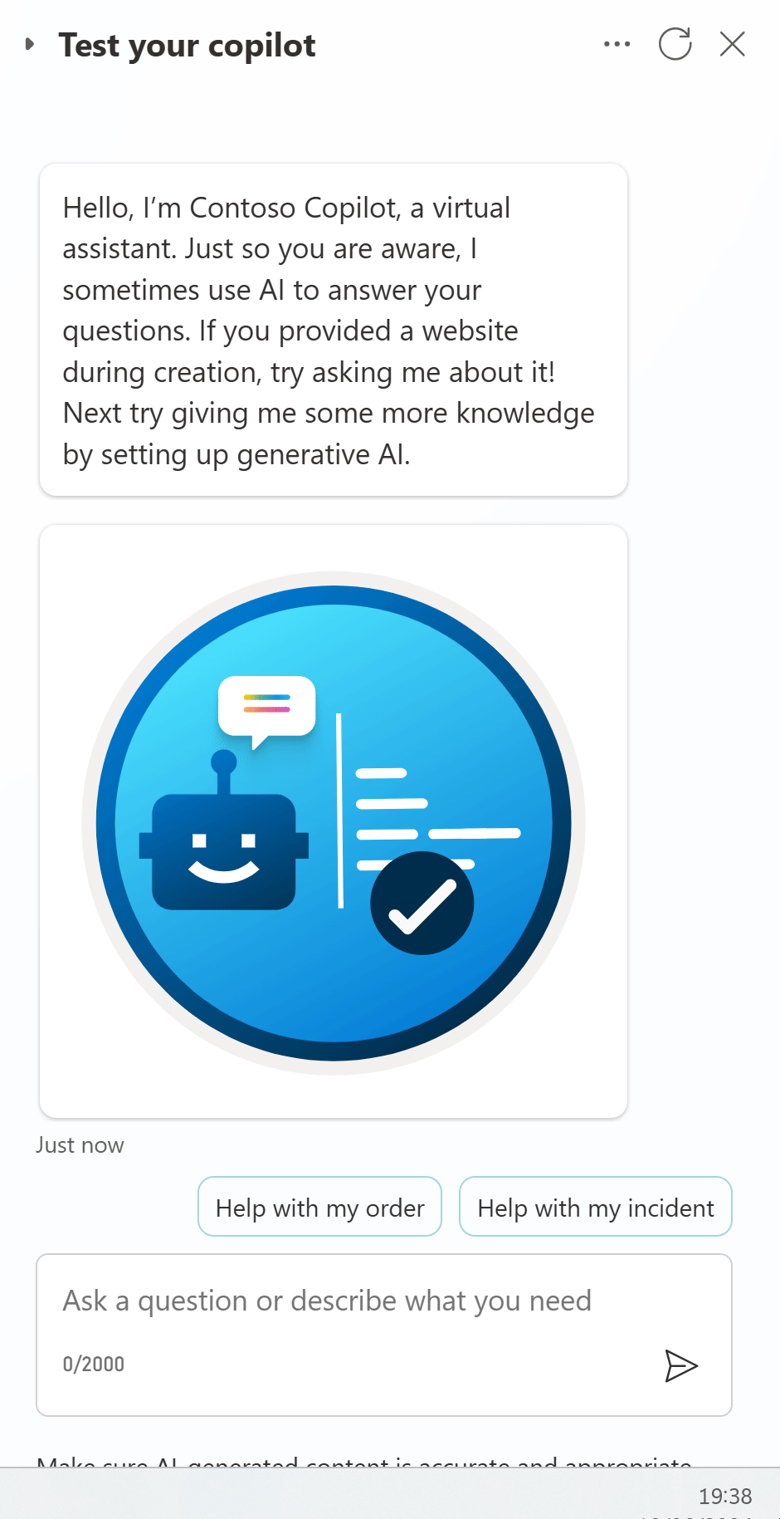
Demo Lab 3

Slide 45



Integration patterns considerations
Power Automate Cloud flows
HTTP requests
& Connectors
Bot Framework
Skills
No-code / low-code.
Clear separation of integration and conversational logic.
Can be monitored separately.
Existing cloud flows can be updated to integrate with Copilot Studio.
No-code / low-code.
Faster runtime execution.
Can be monitored as part of Copilot Studio App Insights integration.
Can leverage variables, including environment variables and secrets.
Variables, conditions, parameters, etc. can use Power Fx formulas.
Parsing and error handling support.
Synchronous execution.
Support for private endpoints.
Existing Bot Framework investments can be reused.
Invocation and execution of the cloud flow can add latency.
If scale/performance are a concern, the higher-tier “Power Automate Process” plan can be evaluated.
“Power Automate Process” required for service principal ownership.
Need to return results within 100s.
Mixing conversational logic and integration logic, but integration topics can be isolated, as they can be configured for inputs and outputs.
Need to return results within 100s.
Pro-code (e.g., C#)
Runs in the Azure AI Bot Service.
Additional costs need to be covered by an Azure subscription.
ALM differs from Power Platform.

Slide 46
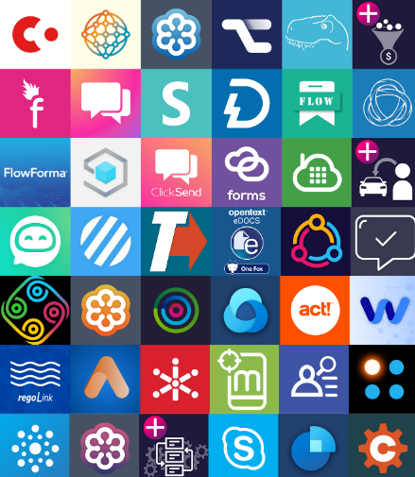


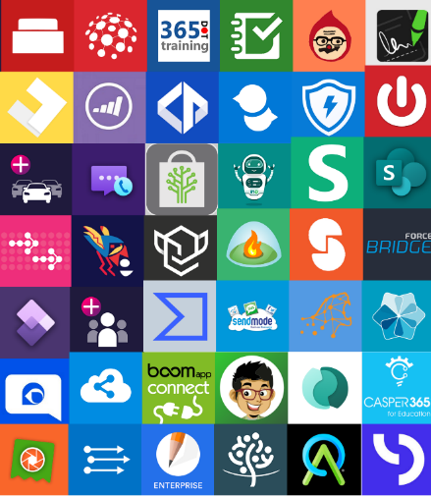



Power Platform Connectors
Multi-Channel
Power Platform, including Power Automate and Copilot Studio, offers great integration capabilities, with more 1,200 native connectors or ways to create your own custom connectors to your APIs.
For a good end-user experience, cloud flows, HTTP requests and connectors triggered from Copilot Studio must execute quickly so that the user doesn’t have to wait too long for the copilot to answer.
Website
Mobile
Teams
Facebook
Power Automate
Telephony
Email
Slack
Copilot
Studio
Direct line Speech
Many more
1200+ prebuilt data connectors

Slide 47
Lab time!
Lab 03 [60] minutes

Slide 48
Lab 04: Make HTTP requests to connect to an API

Slide 49
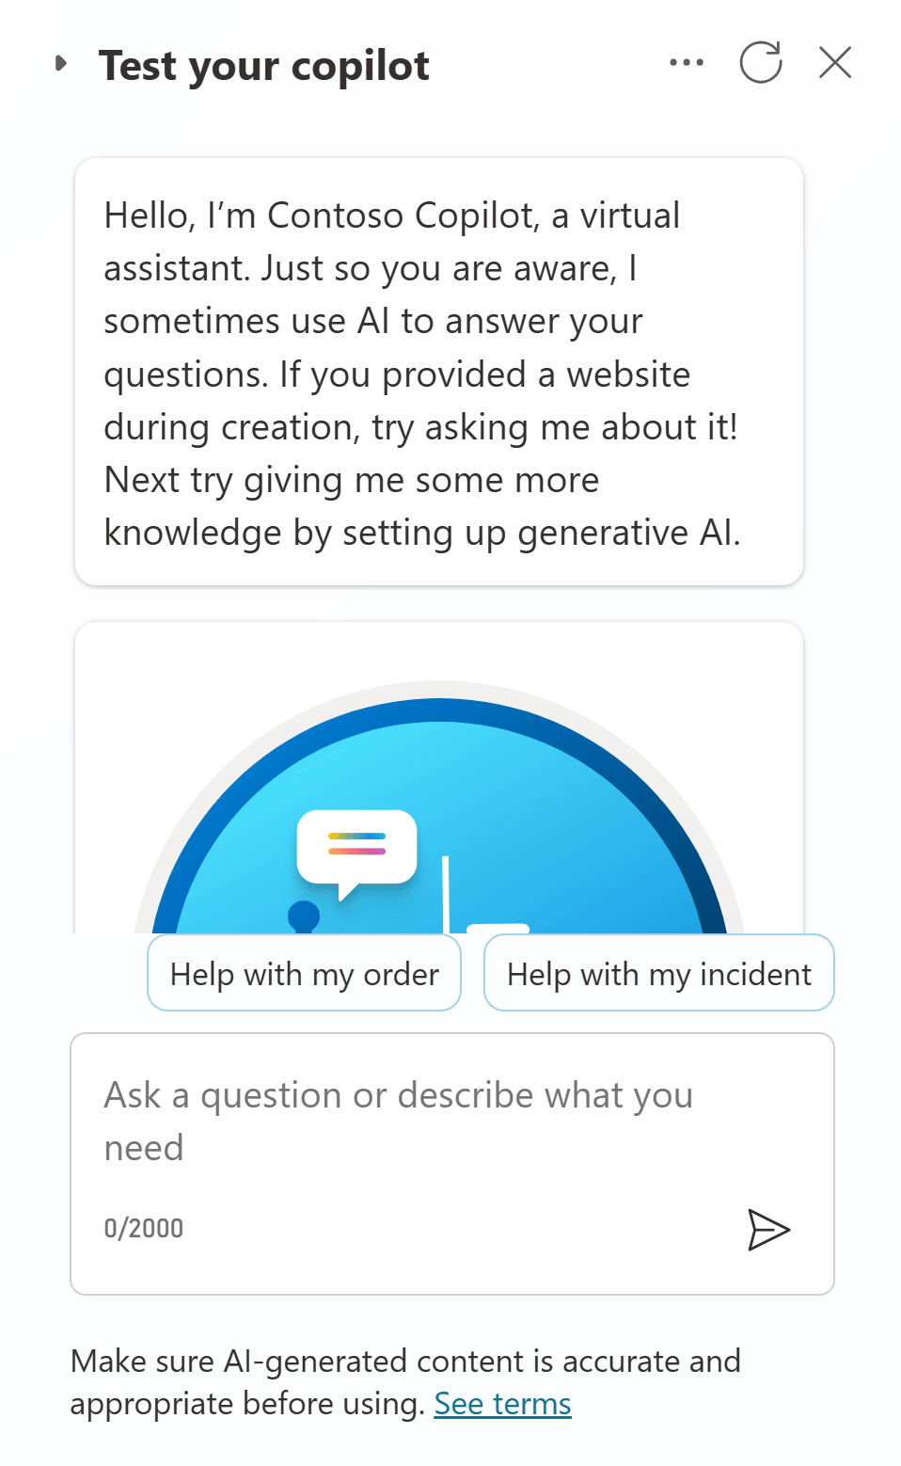
Demo Lab 4

Slide 50
Lab time!
Lab 04 [20] minutes

Slide 51
Lab 05: Knowledge sources, AI knowledge, and custom instructions

Slide 52
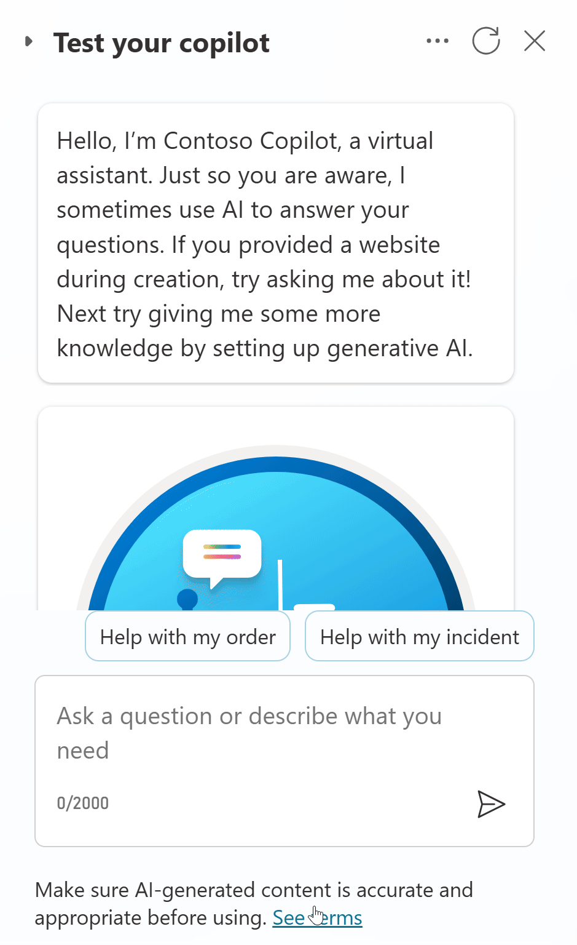
Demo Lab 5

Slide 53
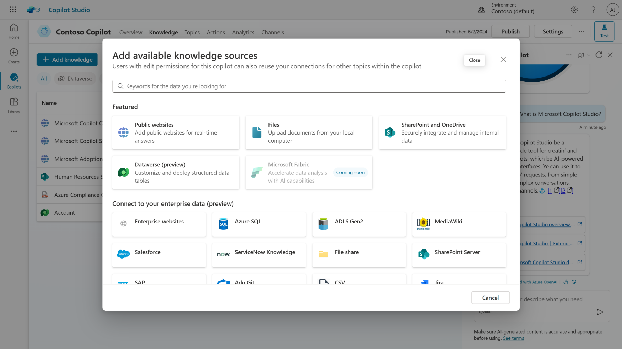
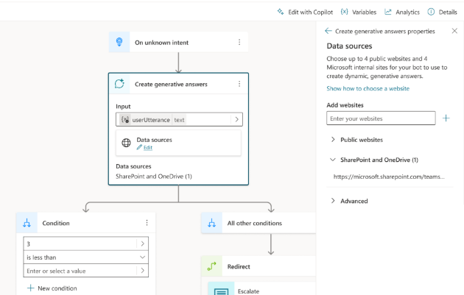
Knowledge sources
Enable multi-turn chat over your own internal and external knowledge sources and sites with generative answers
Copilots can answer thousands of questions out of the box in seconds
You can even pull data from an API or other backend system and enable generative chat over it
Try now at aka.ms/CopilotStudioDemo
Generally Available

Slide 54


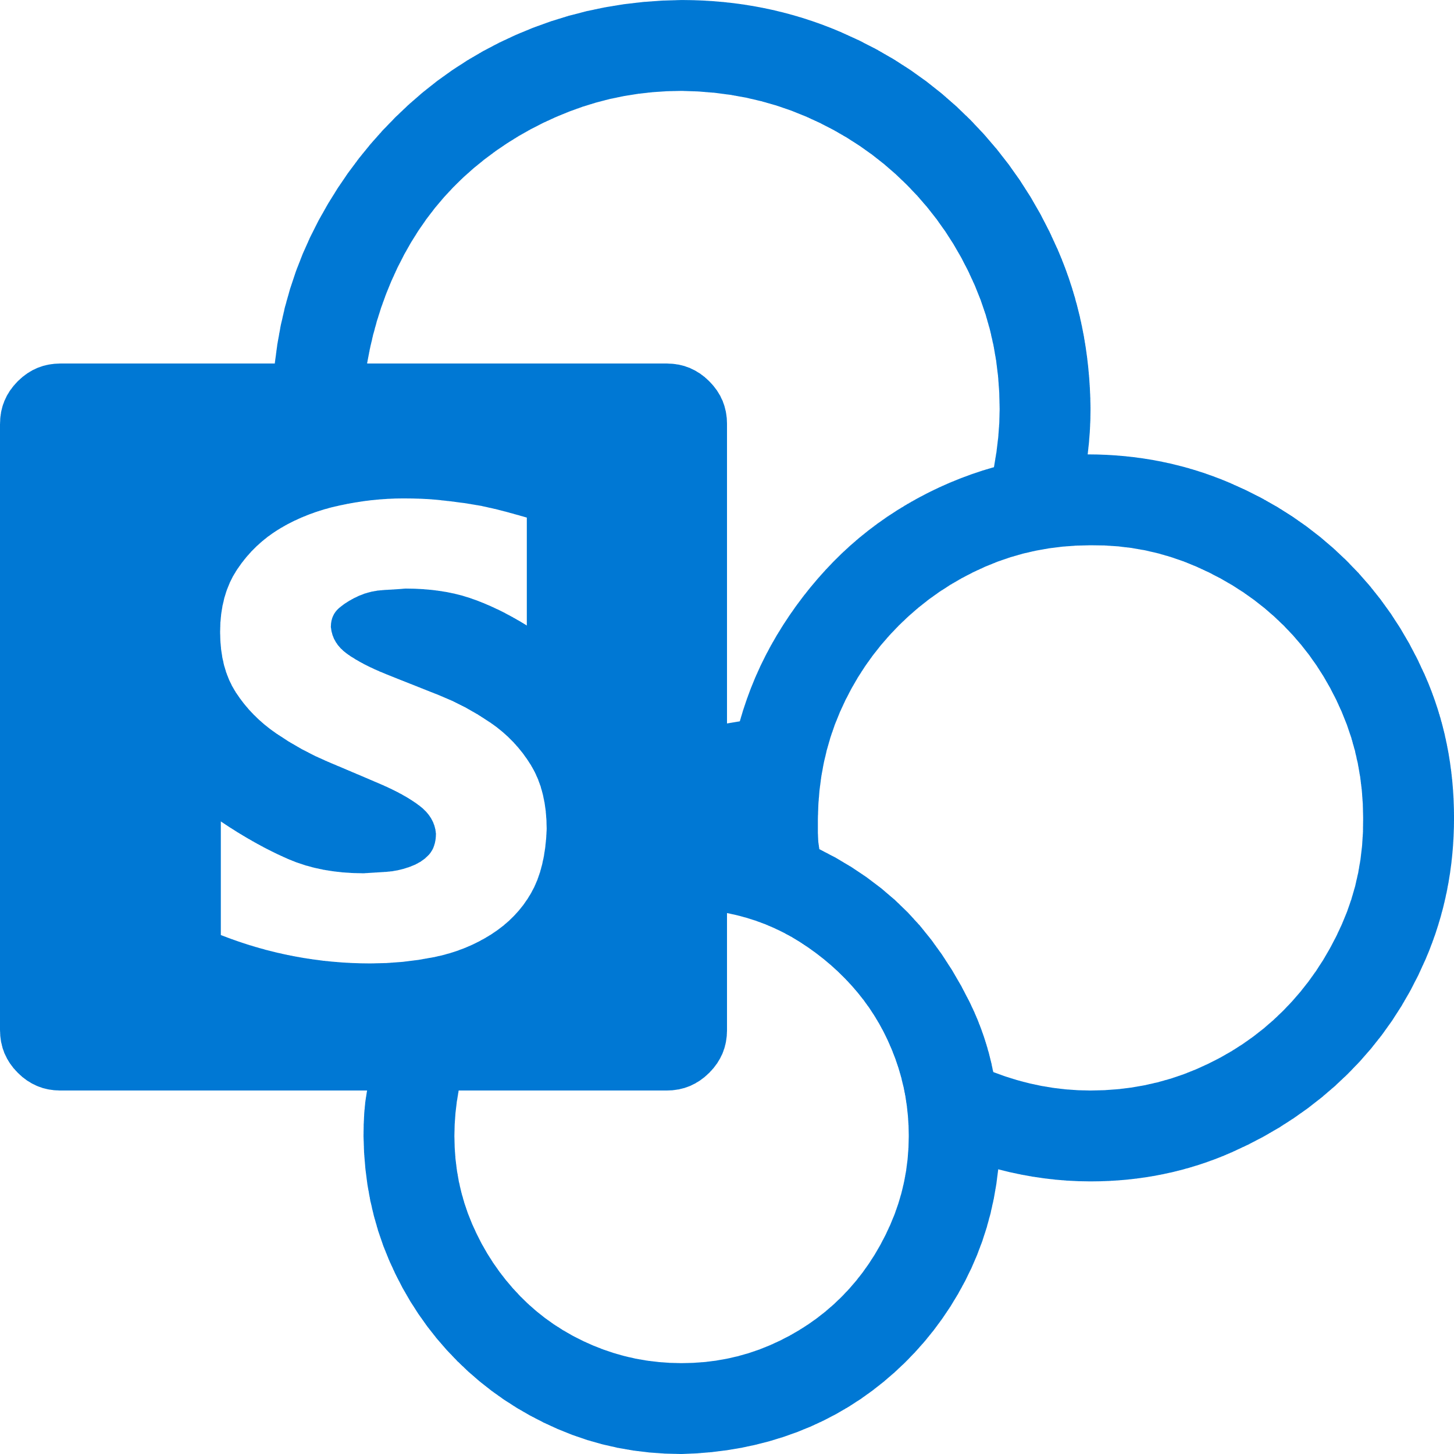









Knowledge sources & Generative AI
Public data
Public Website
Up to 4 URLs, but the list can be dynamic.
Max 2 subpages depth (/en/help/), no direct pages.
Websites must be indexed by Bing.
Bing being a global service, no regional boundary is possible.
One configuration ID, but it can be set using a formula.
Azure costs covered by Microsoft
Up to 400 URLs, custom ranking options.
Max 2 subpages depth (/en/help/), supports direct pages.
Bing Custom Search
1
Query rewriting
Optimizing the user question for search
SharePoint
Requires the user to be authenticated with Entra ID to make delegated calls to the Graph API.
Matching files (max 3 MB) are retrieved to get detailed snippets to summarize.
Up to 4 SharePoint or OneDrive for Business sites (but the list can be dynamic).
Security trimming: returned results only include content the user has read access to.
Users eligible to Microsoft 365 Semantic Index benefit from better results.
Last 10 turns are leveraged for contextualization
Internal only
2
Content retrieval
Azure OpenAI on your data preview
Returns results from the linked Azure AI Search index (keyword, semantic, and vector search).
Not a passthrough to Azure OpenAI – generative answers summarization and validation apply.
Connection isn’t delegated: no security trimming, no authentication requirement for the user.
Can index content from public URLs/web addresses (useful if regional boundary is required).
Querying each source
Top 3 results per source
Files
3
Summarization
Files (max 3 MB) are stored in Dataverse file storage and indexed with Dataverse Search.
Not possible to offer a URL to the source documents in the citations.
Documents are uploaded at the copilot level. Gen Answers node will search across all uploaded documents or none, when disabled at a node level.
Answer summarization from retrieved content
Citation generation
Requires a step to query the data source – using cloud flows, connectors, or HTTP requests.
Results are passed as inputs to the generative answers to summarize an answer for the query.
Input data needs to be in table format, with 3 properties: Content (typically snippets of relevant content) , ContentLocation (optional, typically a URL) and Title (optional).
Custom data
Answer personalization with custom instructions
Validation at each step
Dataverse preview
Moderation of harmful, malicious, uncompliant, or copyrighted answers
Dataverse tables (max 15).
Natural language queries are transformed in analytical queries (e.g., SQL) over structured data
Grounding validation and hallucination removal
Connect to additional enterprise knowledge sources that are indexed in Microsoft Graph.
Salesforce, ServiceNow, Confluence, Azure DevOps Wiki, etc.
Graph Connectors preview

Slide 55




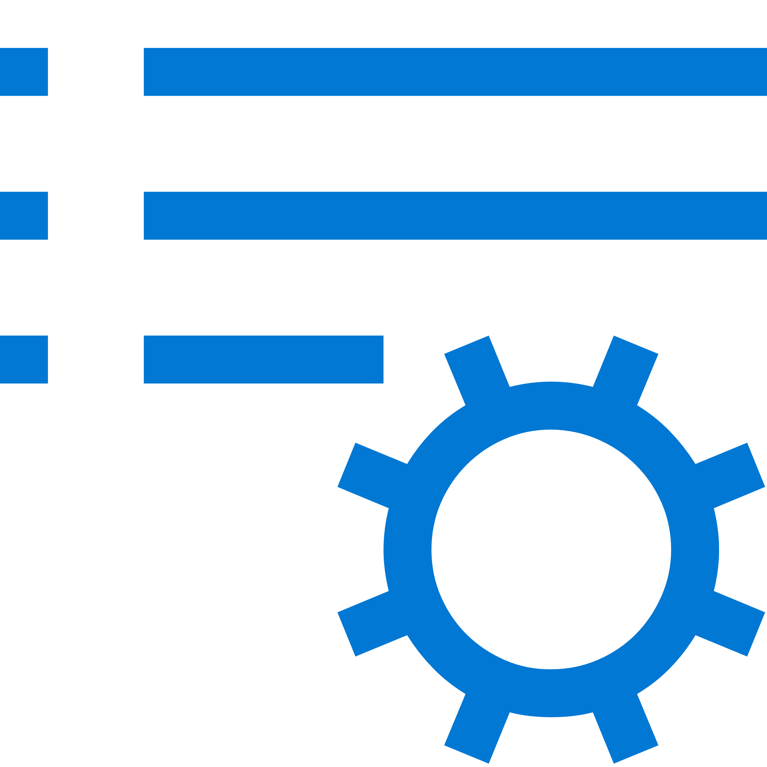





Generative AI security and compliance considerations
The large language models (LLM) Copilot Studio depends upon are the foundation models trained by OpenAI.
Generative answers uses GPT-3.5 Turbo, but as new models outperform previous ones, they can be updated.
Models are hosted on internal Azure OpenAI services, honoring the Microsoft Services Trust boundary.
Models are accessed and used following Microsoft Responsible AI principles and policies.
Custom instructions can be added to generative answers to influence format and filters.
Data storage and processing for Copilot Studio generative AI capabilities may result in data movement across regional boundaries. When local data storage and processing aren’t available in the region, environment settings are available to disable features requiring Azure OpenAI or Bing Search, preventing data movement.
Copilot Studio does not collect, nor provide any customer data, for use in the training of LLMs.
For operations purposes only, conversations are stored temporarily in a service-operated and secured store so that authorized Microsoft employees via Secure Access Workstations (SAWs) with Just-In-Time (JIT) access requests may respond to support requests. Access can be controlled through Customer Lockbox.
Generative AI capabilities log additional troubleshooting data, but only when the thumbs up or down reactions are used by the copilot author in the Copilot Studio test pane.
Given the existing control layers and to avoid further logging of customer data, Azure OpenAI abuse monitoring is disabled for Copilot Studio generative AI features.

Slide 56
Lab time!
Lab 05 [30] minutes

Slide 57
Lab 06: Use generative AI orchestration to interact with your connectors

Slide 58
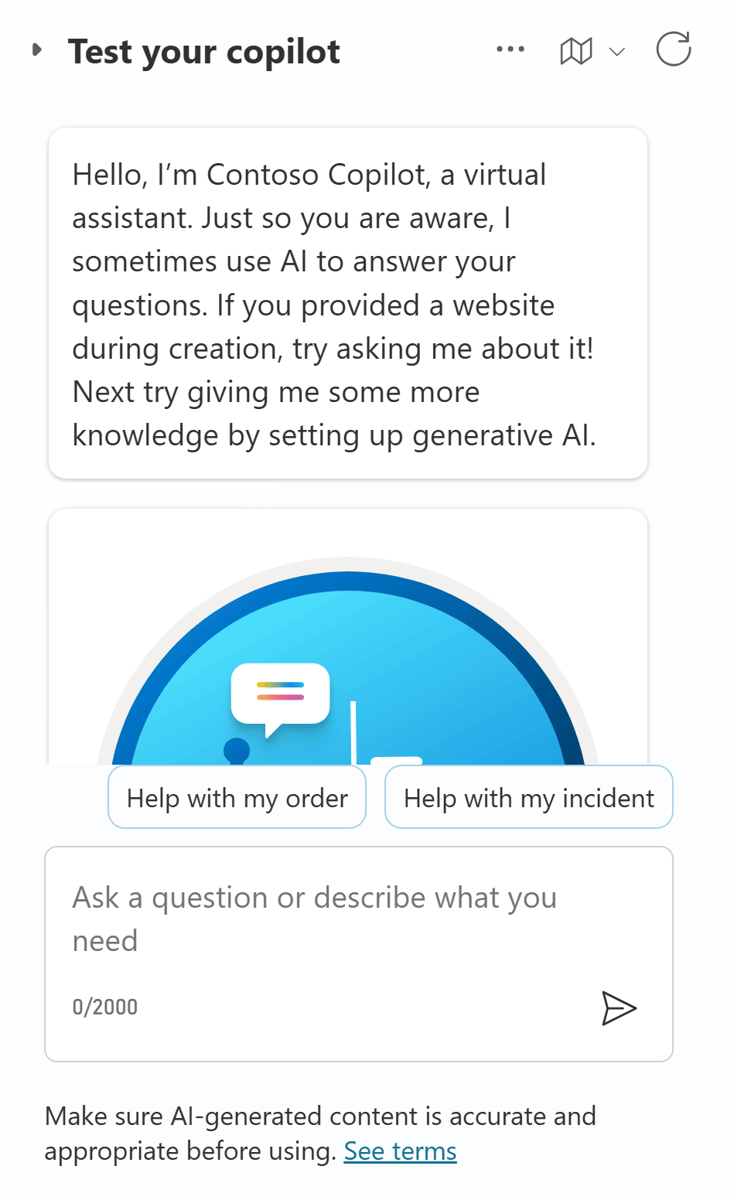
Demo Lab 6

Slide 59
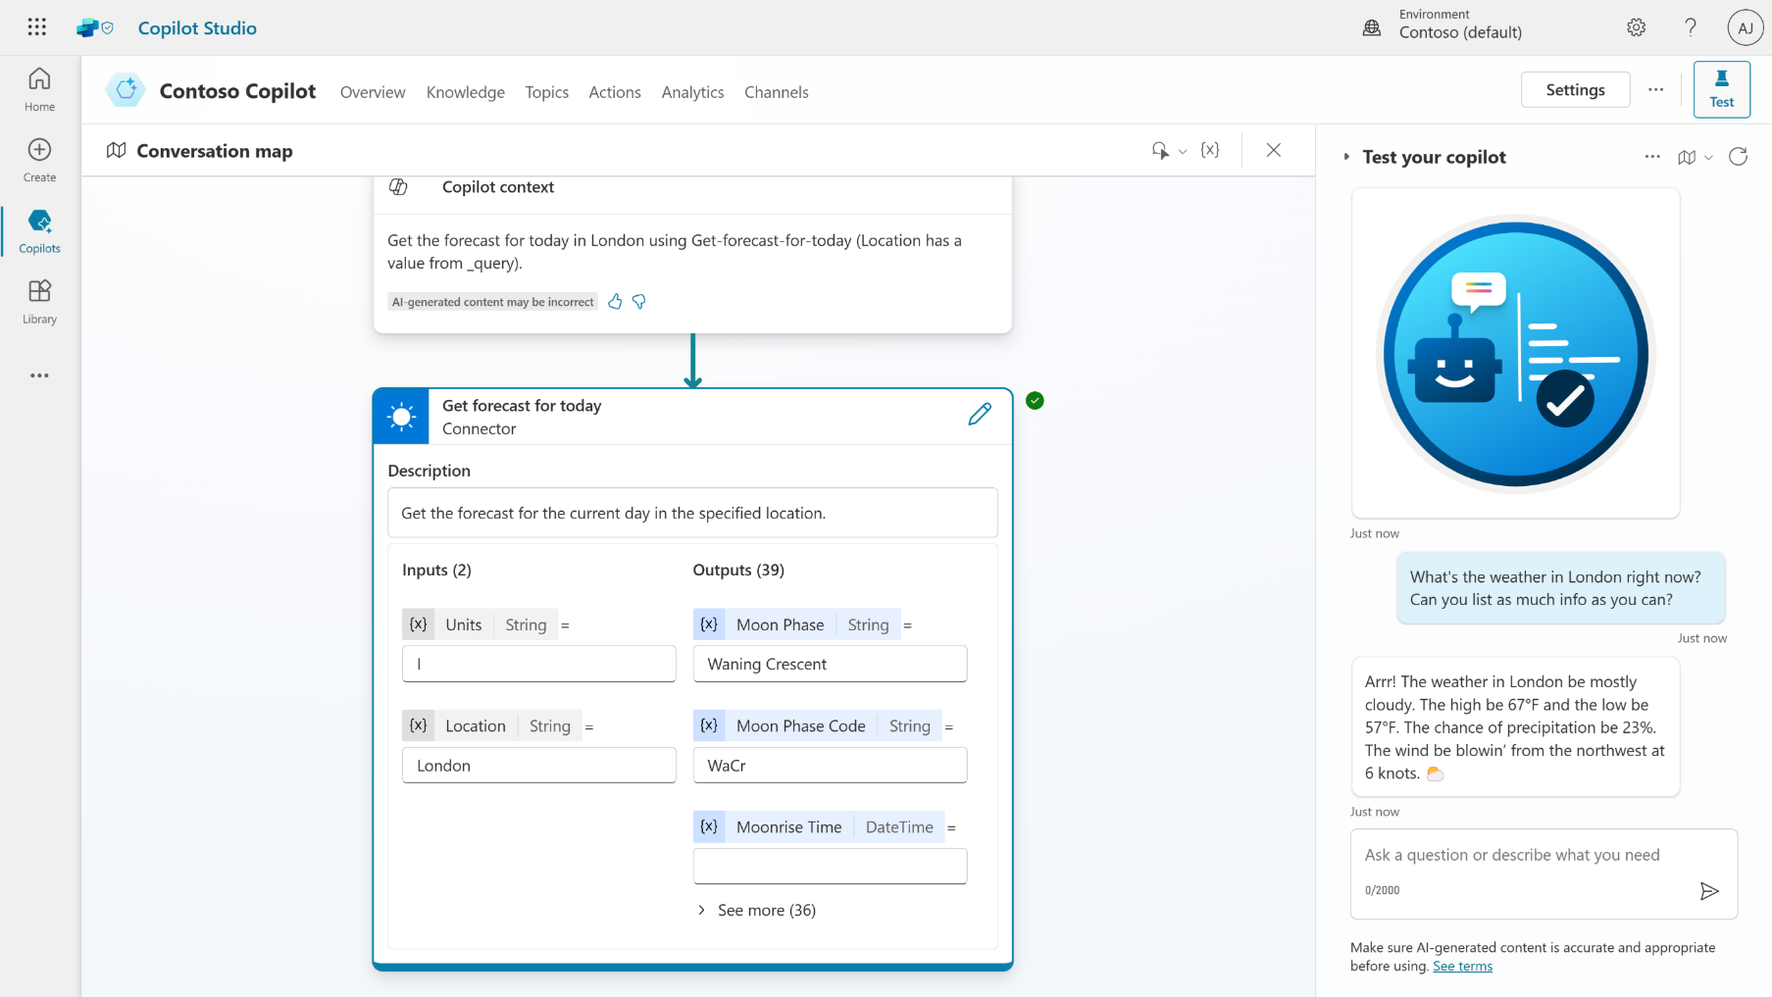
Generative AI orchestration
Test and trace feature to see it in action
Dynamically chains actions and topics together to produce actionable responses
Handle multi-intent queries that were not anticipated or built by the user
Automatically slot-fill further details to get the information needed for the task
Powered by the Azure OpenAI Service with LangChain concepts
Public Preview

Slide 60
Lab time!
Lab 06 [20] minutes

Slide 61
Lab 07: Invoke AI Builder prompts

Slide 62
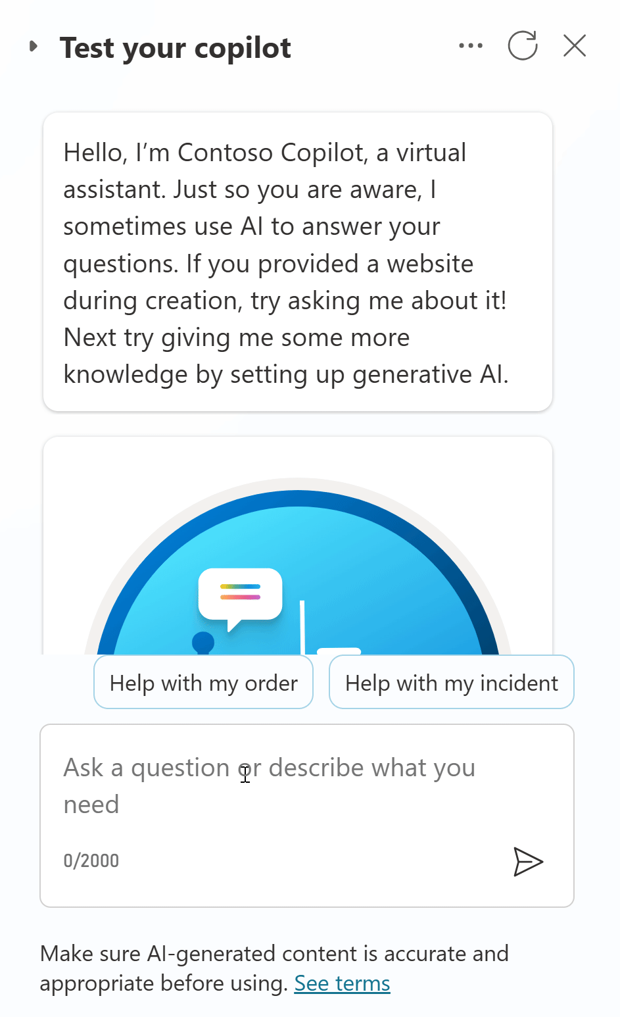
Demo Lab 7

Slide 63
Lab time!
Lab 07 [25] minutes

Slide 64
Q&A

Slide 65
Resources

Slide 66
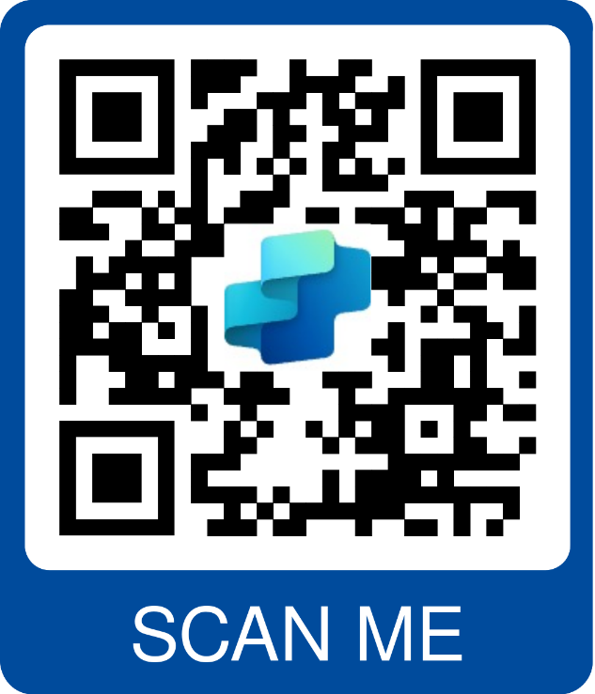
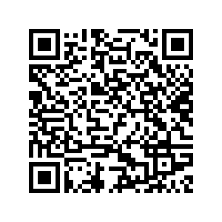

Resources
Copilot Studio trial | aka.ms/TryCopilotStudio
Copilot Studio website | aka.ms/CopilotStudio
Official Blog | aka.ms/CopilotStudioBlog
Copilot Studio Demo | aka.ms/CopilotStudioDemo
Product documentation | aka.ms/CopilotStudioDocs
Product guidance | aka.ms/CopilotStudioGuidance
Implementation guide | aka.ms/CopilotStudioImplementationGuide
Community | aka.ms/CopilotStudioCommunity
Follow-up Session on 1/31

